Slide 1
UNIT-II: DATA LINK LAYER AND MEDIUM ACCESS CONTROL SUBLAYER
Data Link Layer: Data link layer design issues, Error detection and correction-CRC, Hamming codes, Elementary data link protocols, Sliding window protocols.
Medium Access Control Sublayer: ALOHA, Carrier sense multiple access protocols, Collision-free protocols, Ethernet, Data link layer switching-Repeaters, Hubs, Switches, Routers, and Gateways.

Slide 2
DATA LINK LAYER DESIGN ISSUES
The data link layer uses the services of the physical layer to send and receive bits over communication channels.
It has a number of functions, including:
1. Providing a well-defined service interface to the network layer.
2. Dealing with transmission errors.
3. Regulating the flow of data so that slow receivers are not swamped by fast senders.
Each frame contains a frame header, a payload field for holding the packet, and a frame trailer.

Slide 3
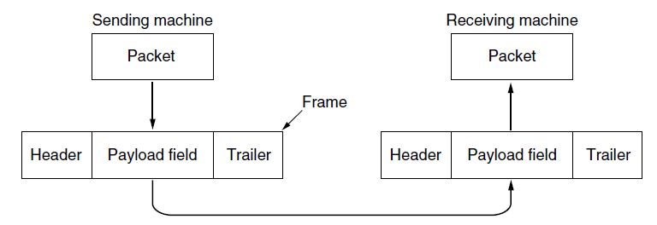
Relationship between packets and frames

Slide 4
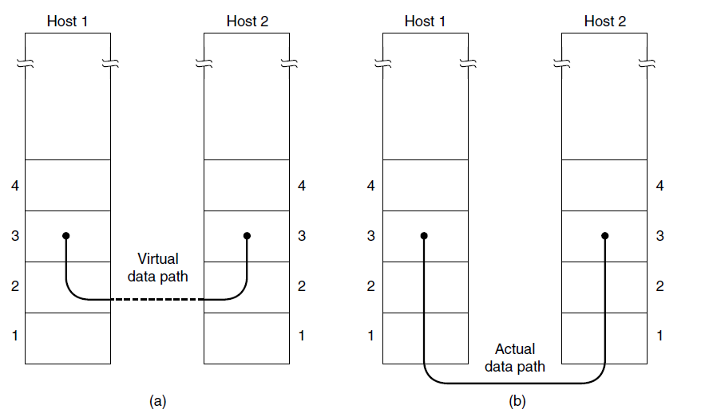
Services Provided to the Network Layer
1. Unacknowledged connectionless service.
2. Acknowledged connectionless service.
3. Acknowledged connection-oriented service.
(a) Virtual communication. (b) Actual communication.

Slide 5
Error Detection and Correction
The Error-correcting Codes:
Hamming Codes.
Binary convolutional Codes.
Reed-Solomon Codes.
Low-Density Parity Check Codes.
Three different Error-detecting Codes.
Parity.
Checksums.
Cyclic Redundancy Checks (CRCs).

Slide 6
1. Hamming Code
Hamming code is a set of error-correction codes that can be used to detect and correct the errors that can occur when the data is moved or stored from the sender to the receiver. It is technique developed by R.W. Hamming for error correction.
Redundant bits –
Redundant bits are extra binary bits that are generated and added to the information-carrying bits of data transfer to ensure that no bits were lost during the data transfer.
The number of redundant bits can be calculated using the following formula:
2^r ≥ m + r + 1
where, r = redundant bit, m = data bit

Slide 7
Suppose the number of data bits is 7, then the number of redundant bits can be calculated using: = 2^4 ≥ 7 + 4 + 1 Thus, the number of redundant bits= 4
Parity bits –
A parity bit is a bit appended to a data of binary bits to ensure that the total number of 1’s in the data are even or odd. Parity bits are used for error detection.

Slide 8
There are two types of parity bits:
Even parity bit: In the case of even parity, for a given set of bits, the number of 1’s are counted. If that count is odd, the parity bit value is set to 1, making the total count of occurrences of 1’s an even number. If the total number of 1’s in a given set of bits is already even, the parity bit’s value is 0.
Odd Parity bit – In the case of odd parity, for a given set of bits, the number of 1’s are counted. If that count is even, the parity bit value is set to 1, making the total count of occurrences of 1’s an odd number. If the total number of 1’s in a given set of bits is already odd, the parity bit’s value is 0.

Slide 9
General Algorithm of Hamming code –
The Hamming Code is simply the use of extra parity bits to allow the identification of an error.
Write the bit positions starting from 1 in binary form (1, 10, 11, 100, etc).
All the bit positions that are a power of 2 are marked as parity bits (1, 2, 4, 8, etc).
All the other bit positions are marked as data bits.
Each data bit is included in a unique set of parity bits, as determined its bit position in binary form.

Slide 10
Parity bit 1 covers all the bits positions whose binary representation includes a 1 in the least significant position (1, 3, 5, 7, 9, 11, etc).
Parity bit 2 covers all the bits positions whose binary representation includes a 1 in the second position from the least significant bit (2, 3, 6, 7, 10, 11, etc).
Parity bit 4 covers all the bits positions whose binary representation includes a 1 in the third position from the least significant bit (4–7, 12– 15, 20–23, etc).
Parity bit 8 covers all the bits positions whose binary representation includes a 1 in the fourth position from the least significant bit bits (8–15, 24–31, 40–47, etc).
In general each parity bit covers all bits where the bitwise AND of the parity position and the bit position is non-zero.
Since we check for even parity set a parity bit to 1 if the total number of ones in the positions it checks is odd.
Set a parity bit to 0 if the total number of ones in the positions it checks is even.

Slide 11
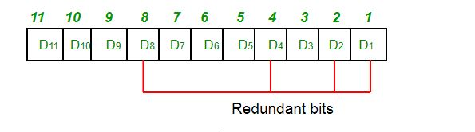
Determining the position of redundant bits – These redundancy bits are placed at the positions which correspond to the power of 2. As in the above example:
The number of data bits = 7
The number of redundant bits = 4
The total number of bits = 11
The redundant bits are placed at positions corresponding to power of 2- 1, 2, 4, and 8

Slide 12
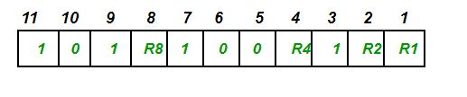
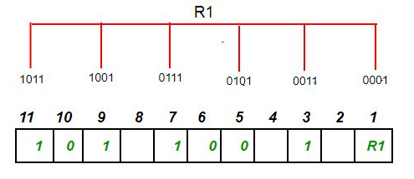
Suppose the data to be transmitted is 1011001, the bits will be placed as follows:
Determining the Parity bits –
R1 bit is calculated using parity check at all the bits positions whose binary representation includes a 1 in the least significant position.
R1: bits 1, 3, 5, 7, 9, 11
To find the redundant bit R1, we check for even parity. Since the total number of 1’s in all the bit positions corresponding to R1 is an even number the value of R1 (parity bit’s value) = 0

Slide 13
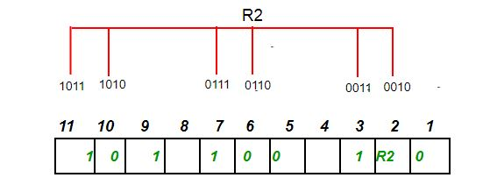
2. R2 bit is calculated using parity check at all the bits positions whose binary representation includes a 1 in the second position from the least significant bit.
R2: bits 2,3,6,7,10,11
To find the redundant bit R2, we check for even parity. Since the total number of 1’s in all the bit positions corresponding to R2 is an odd number the value of R2(parity bit’s value)=1

Slide 14
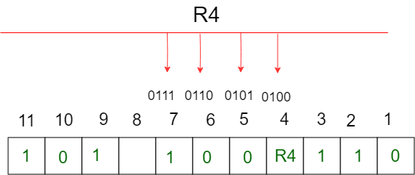
3. R4 bit is calculated using parity check at all the bits positions whose binary representation includes a 1 in the third position from the least significant bit.
R4: bits 4, 5, 6, 7
To find the redundant bit R4, we check for even parity. Since the total number of 1’s in all the bit positions corresponding to R4 is an odd number the value of R4(parity bit’s value) = 1

Slide 15
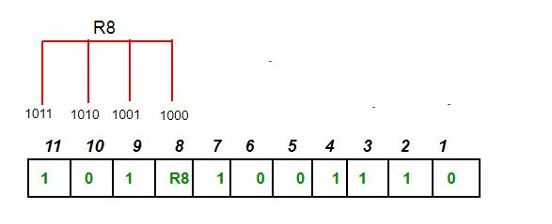
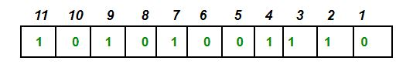
4. R8 bit is calculated using parity check at all the bits positions whose binary representation includes a 1 in the fourth position from the least significant bit.
R8: bit 8,9,10,11
To find the redundant bit R8, we check for even parity. Since the total number of 1’s in all the bit positions corresponding to R8 is an even number the value of R8(parity bit’s value)=0.
Thus, the data transferred is:

Slide 16
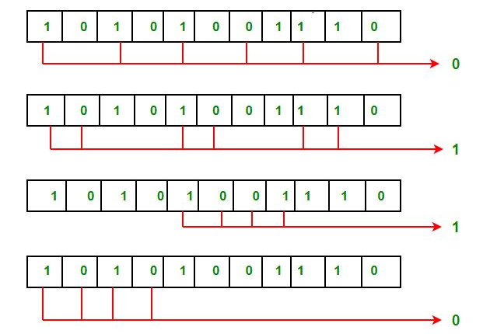
Error detection and correction –
Suppose in the above example the 6th bit is changed from 0 to 1 during data transmission, then it gives new parity values in the binary number:
The bits give the binary number as 0110 whose decimal representation is 6. Thus, the bit 6 contains an error. To correct the error the 6th bit is changed from 1 to 0.

Slide 17
2. Binary convolutional codes:
An encoder processes a sequence of input bits and generates a sequence of output bits. There is no natural message size or encoding boundary as in a block code.
The output depends on the current and previous input bits. That is, the encoder has memory.
The number of previous bits on which the output depends is called the constraint length of the code. Convolutional codes are specified in terms of their rate and constraint length.
Convolutional codes are widely used in deployed networks.

Slide 18
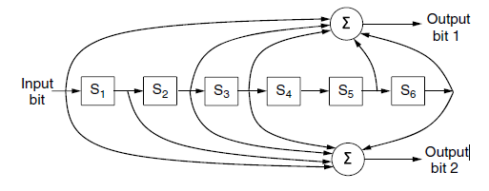
The NASA binary convolutional code used in 802.11.
Each input bit on the left-hand side produces two output bits on the right-hand side that are XOR sums of the input and internal state.
Since it deals with bits and performs linear operations, this is a binary, linear convolutional code.
Since 1 input bit produces 2 output bits, the code rate is 1/2. It is not systematic since none of the output bits is simply the input bit.

Slide 19
3. Reed-Solomon code:
Like Hamming codes, Reed-Solomon codes are linear block codes, and they are often systematic too. Unlike Hamming codes, which operate on individual bits, Reed-Solomon codes operate on m bit symbols.
Reed-Solomon codes are based on the fact that every n degree polynomial is uniquely determined by n + 1 points.
Reed-Solomon codes are widely used in practice because of their strong error-correction properties, particularly for burst errors. They are used for DSL, data over cable, satellite communications, and perhaps most ubiquitously on CDs, DVDs, and Blu-ray discs.
Reed-Solomon codes are often used in combination with other codes such as a convolutional code.
Convolutional codes are effective at handling isolated bit errors, but they will fail, likely with a burst of errors, if there are too many errors in the received bit stream.
By adding a Reed-Solomon code within the convolutional code, the Reed-Solomon decoding can mop up the error bursts, a task at which it is very good. The overall code then provides good protection against both single and burst errors.

Slide 20
4. LDPC (Low-Density Parity Check) code.
In an LDPC code, each output bit is formed from only a fraction of the input bits.
This leads to a matrix representation of the code that has a low density of 1s, hence the name for the code.
The received codewords are decoded with an approximation algorithm that iteratively improves on a best fit of the received data to a legal codeword. This corrects errors.
LDPC codes are practical for large block sizes and have excellent error-correction abilities that outperform many other codes (including the ones we have looked at) in practice. For this reason they are rapidly being included in new protocols.
They are part of the standard for digital video broadcasting, 10 Gbps Ethernet, power-line networks, and the latest version of 802.11. Expect to see more of them in future networks.

Slide 21
Error-correcting codes
Error-correcting codes are widely used on wireless links, which are notoriously noisy and error prone when compared to optical fibers.
However, over fiber or high-quality copper, the error rate is much lower, so error detection and retransmission is usually more efficient there for dealing with the occasional error.
Three different error-detecting codes. They are all linear, systematic block codes:
Parity.
Checksums.
Cyclic Redundancy Checks (CRCs).

Slide 22
1. Parity bit
A single parity bit is appended to the data.
The parity bit is chosen so that the number of 1 bits in the codeword is even (or odd).
Doing this is equivalent to computing the (even) parity bit as the modulo 2 sum or XOR of the data bits.
For example, when 1011010 is sent in even parity, a bit is added to the end to make it 10110100.
With odd parity 1011010 becomes 10110101.
A code with a single parity bit has a distance of 2, since any single-bit error produces a codeword with the wrong parity. This means that it can detect single-bit errors.
One difficulty with this scheme is that a single parity bit can only reliably detect a single-bit error in the block. If the block is badly garbled by a long burst error, the probability that the error will be detected is only 0.5, which is hardly acceptable.

Slide 23
However, there is something else we can do that provides better protection against burst errors: we can compute the parity bits over the data in a different order than the order in which the data bits are transmitted. Doing so is called Interleaving.
In this case, we will compute a parity bit for each of the n columns and send all the data bits as k rows, sending the rows from top to bottom and the bits in each row from left to right in the usual manner.
At the last row, we send the n parity bits.
This transmission order is shown in Fig. 3-8 for n = 7 and k = 7.
Interleaving is a general technique to convert a code that detects (or corrects) isolated errors into a code that detects (or corrects) burst errors.

Slide 24
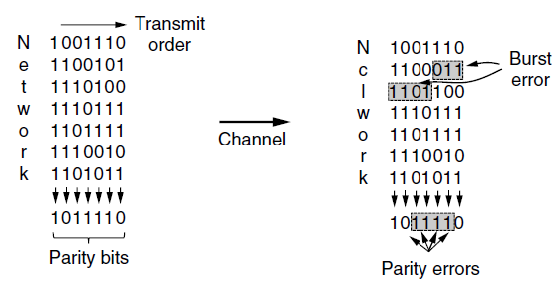
Figure 3-8. Interleaving of parity bits to detect a burst error.
Interleaving is a general technique to convert a code that detects (or corrects) isolated errors into a code that detects (or corrects) burst errors.
In Fig. 3-8, when a burst error of length n = 7 occurs, the bits that are in error are spread across different columns.

Slide 25
Checksum
Checksum, is closely related to groups of parity bits.
The word ‘‘checksum’’ is often used to mean a group of check bits associated with a message, regardless of how are calculated.
A group of parity bits is one example of a checksum.
The checksum is usually placed at the end of the message, as the complement of the sum function.
This way, errors may be detected by summing the entire received codeword, both data bits and checksum.
If the result comes out to be zero, no error has been detected.

Slide 26
One example of a checksum is the 16-bit Internet checksum used on all Internet packets as part of the IP protocol (Braden et al., 1988).
This checksum is a sum of the message bits divided into 16-bit words.
Because this method operates on words rather than on bits, as in parity, errors that leave the parity unchanged can still alter the sum and be detected.
For example, if the lowest order bit in two different words is flipped from a 0 to a 1, a parity check across these bits would fail to detect an error.
However, two 1s will be added to the 16-bit checksum to produce a different result.
The error can then be detected.
The Internet checksum in particular is efficient and simple but provides weak protection in some cases precisely because it is a simple sum.
It does not detect the deletion or addition of zero data, nor swapping parts of the message, and it provides weak protection against message splices in which parts of two packets are put together.

Slide 27
Cyclic Redundancy Check and Modulo-2 Division
CRC (Cyclic Redundancy Check), also known as a polynomial code.
CRC or Cyclic Redundancy Check is a method of detecting accidental changes/errors in communication channel.
CRC uses Generator Polynomial which is available on both sender and receiver side.
An example generator polynomial is of the form like
x³ + x + 1.
This generator polynomial represents key 1011.
Another example is x² + 1 that represents key 101.
n : Number of bits in data to be sent from sender side.
k : Number of bits in the key obtained from generator polynomial.

Slide 28
Sender Side (Generation of Encoded Data from Data and Generator Polynomial (or Key)):
The binary data is first augmented by adding k-1 zeros in the end of the data
Use modulo-2 binary division to divide binary data by the key and store remainder of division.
Append the remainder at the end of the data to form the encoded data and send the same

Slide 29
Receiver Side (Check if there are errors introduced in transmission) Perform modulo-2 division again and if remainder is 0, then there are no errors.
In this article we will focus only on finding the remainder i.e. check word and the code word.
Modulo 2 Division:
The process of modulo-2 binary division is the same as the familiar division process we use for decimal numbers. Just that instead of subtraction, we use XOR here.
In each step, a copy of the divisor (or data) is XORed with the k bits of the dividend (or key).
The result of the XOR operation (remainder) is (n-1) bits, which is used for the next step after 1 extra bit is pulled down to make it n bits long.
When there are no bits left to pull down, we have a result. The (n-1)-bit remainder which is appended at the sender side.

Slide 30
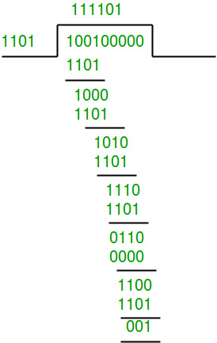
Example 1 (No error in transmission):
Data word to be sent - 100100
Key - 1101 [Or generator polynomial x³ + x² + 1]
Sender Side:
Therefore, the remainder is 001 and hence the encoded data sent is 100100001.

Slide 31
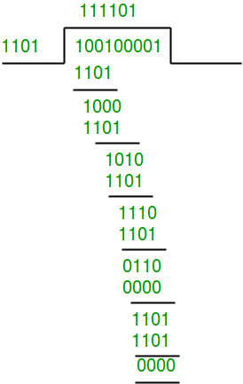
Receiver Side:
Code word received at the receiver side 100100001
Therefore, the remainder is all zeros. Hence, the data received has no error.

Slide 32
Example 2: (Error in transmission)
Data word to be sent - 100100
Key - 1101
Sender Side:
Therefore, the remainder is 001 and hence the code word sent is 100100001.

Slide 33
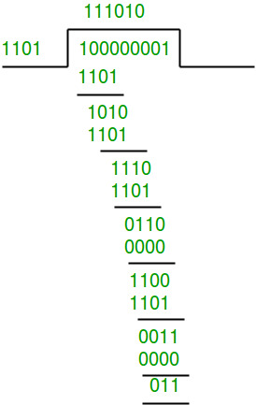
Receiver Side
Let there be error in transmission media Code word received at the receiver side - 100000001
Since the remainder is not all zeroes, the error is detected at the receiver side.

Slide 34
ELEMENTARY DATA LINK PROTOCOLS

Slide 35
A Utopian Simplex Protocol
Data are transmitted in one direction only.
Both the transmitting and receiving network layers are always ready.
Processing time can be ignored.
Infinite buffer space is available.
And best of all, the communication channel between the data link layers never damages or loses frames.
Unrealistic protocol.
The protocol consists of two distinct procedures, a sender and a receiver.
The sender runs in the data link layer of the source machine, and the receiver runs in the data link layer of the destination machine.
No sequence numbers or acknowledgements are used here, so MAX SEQ is not needed.
The only event type possible is frame arrival (i.e., the arrival of an undamaged frame).

Slide 36
A utopian simplex protocol.
/* Protocol 1 (Utopia) provides for data transmission in one direction only, from sender to receiver.
The communication channel is assumed to be error free and the receiver is assumed to be able to process all the input infinitely quickly.
Consequently, the sender just sits in a loop pumping data out onto the line as fast as it can. */
The utopia protocol is unrealistic because it does not handle either flow control or error correction.
Its processing is close to that of an unacknowledged connectionless service that relies on higher layers to solve these problems, though even an unacknowledged connectionless service would do some error detection.

Slide 37
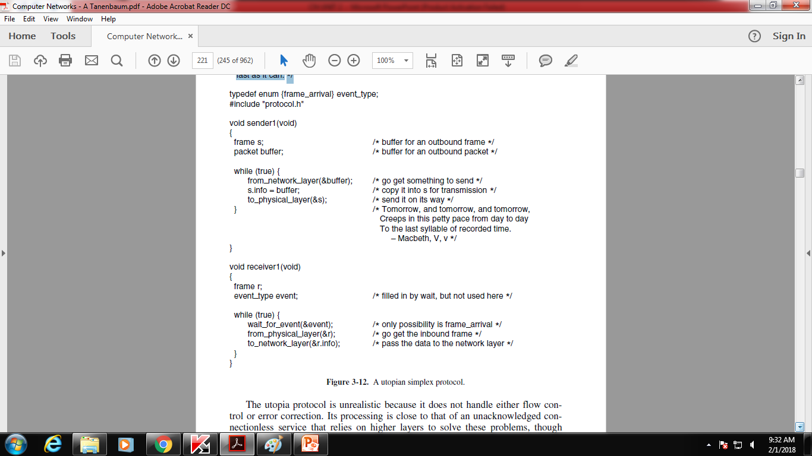
A utopian simplex protocol.

Slide 38
A Simplex Stop-and-Wait Protocol for an Error-Free Channel
The receiver provide feedback to the sender.
After having passed a packet to its network layer, the receiver sends a little dummy frame back to the sender which, in effect, gives the sender permission to transmit the next frame.
After having sent a frame, the sender is required by the protocol to bide its time until the little dummy (i.e., acknowledgement) frame arrives.
This delay is a simple example of a flow control protocol.
Protocols in which the sender sends one frame and then waits for an acknowledgement before proceeding are called stop-and-wait.
Data traffic is simplex, going only from the sender to the receiver, frames do travel in both directions.
first the sender sends a frame, then the receiver sends a frame, then the sender sends another frame, then the receiver sends another one, and so on.
A half duplex physical channel would sufficient here.

Slide 39
The only difference between receiver1 and receiver2 is that after delivering a packet to the network layer, receiver2 sends an acknowledgement frame back to the sender before entering the wait loop again.
Because only the arrival of the frame back at the sender is important, not its contents, the receiver need not put any particular information in it.
/* Protocol 2 (Stop-and-wait) also provides for a one-directional flow of data from sender to receiver.
The communication channel is once again assumed to be error free, as in protocol 1.
However, this time the receiver has only a finite buffer capacity and a finite processing speed, so the protocol must explicitly prevent the sender from flooding the receiver with data faster than it can be handled. */

Slide 40
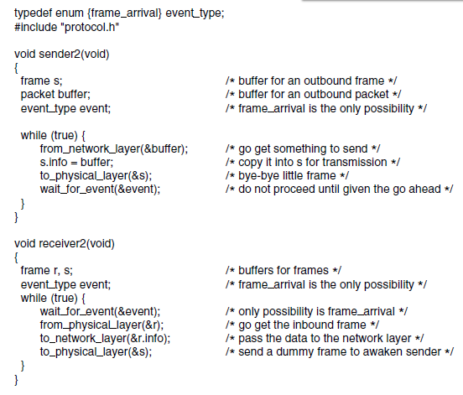
A simplex stop-and-wait protocol.

Slide 41
3. A Simplex Stop-and-Wait Protocol for a Noisy Channel
If the frame is damaged in such a way that the checksum is nevertheless correct—an unlikely occurrence—this protocol (and all other protocols) can fail (i.e., deliver an incorrect packet to the network layer).
At first glance it might seem that a variation of protocol 2 would work: adding a timer.
The sender could send a frame, but the receiver would only send an acknowledgement frame if the data were correctly received.
If a damaged frame arrived at the receiver, it would be discarded. After a while the sender would time out and send the frame again. This process would be repeated until the frame finally arrived completely.
The goal of the data link layer is to provide error-free, transparent communication between network layer processes.

Slide 42
Consider the following scenario:
The network layer on A gives packet 1 to its data link layer. The packet is correctly received at B and passed to the network layer on B. B sends an acknowledgement frame back to A.
The acknowledgement frame gets lost completely. It just never arrives at all. Life would be a great deal simpler if the channel confused and lost only data frames and not control frames, but sad to say, the channel is not very discriminating.
The data link layer on A eventually times out. Not having received an acknowledgement, it (incorrectly) assumes that its data frame was lost or damaged and sends the frame containing packet 1 again.
The duplicate frame also arrives intact at the data link layer on B and is innocently passed to the network layer there. If A is sending a file to B, part of the file will be duplicated (i.e., the copy of the file made by B will be incorrect and the error will not have been detected). In other words, the protocol will fail.

Slide 43
Protocols in which the sender waits for a positive acknowledgement before advancing to the next data item are often called ARQ (Automatic Repeat reQuest) or PAR (Positive Acknowledgement with Retransmission). Like protocol 2, this one also transmits data only in one direction.
Protocol 3 differs from its predecessors in that both sender and receiver have a variable whose value is remembered while the data link layer is in the wait state.
The sender remembers the sequence number of the next frame to send in next frame to send; the receiver remembers the sequence number of the next frame expected in frame expected.
Each protocol has a short initialization phase before entering the infinite loop.
After transmitting a frame, the sender starts the timer running. If it was already running, it will be reset to allow another full timer interval. The interval should be chosen to allow enough time for the frame to get to the receiver, for the receiver to process it in the worst case, and for the acknowledgement frame to propagate back to the sender.

Slide 44
4. SLIDING WINDOW PROTOCOLS
Why?
Efficiency – bandwidth*delay product
Efficiency – when errors occur
A One-Bit Sliding Window Protocol
A Protocol Using Go Back N
A Protocol Using Selective Repeat.
When a data frame arrives, instead of immediately sending a separate control frame, the receiver restrains itself and waits until the network layer passes it the next packet.
The acknowledgement is attached to the outgoing data frame (using the ack field in the frame header).
In effect, the acknowledgement gets a free ride on the next outgoing data frame.
The technique of temporarily delaying outgoing acknowledgements so that they can be hooked onto the next outgoing data frame is known as piggybacking.

Slide 45
A sliding window protocol is a feature of packet-based data transmission protocols.
Sliding window protocols are used where reliable in-order delivery of packets is required, such as in the Data Link Layer (OSI model) as well as in the Transmission Control Protocol (TCP).
Conceptually, each portion of the transmission (packets in most data link layers, but bytes in TCP) is assigned a unique consecutive sequence number, and the receiver uses the numbers to place received packets in the correct order, discarding duplicate packets and identifying missing ones.
The problem with this is that there is no limit on the size of the sequence number that can be required.
The principal advantage of using piggybacking over having distinct acknowledgement frames is a better use of the available channel bandwidth.
The ack field in the frame header costs only a few bits, where as a separate frame would need a header, the acknowledgement, and a checksum.

Slide 46
The term "window" on the transmitter side represents the logical boundary of the total number of packets yet to be acknowledged by the receiver.
The receiver informs the transmitter in each acknowledgment packet the current maximum receiver buffer size (window boundary).

Slide 47
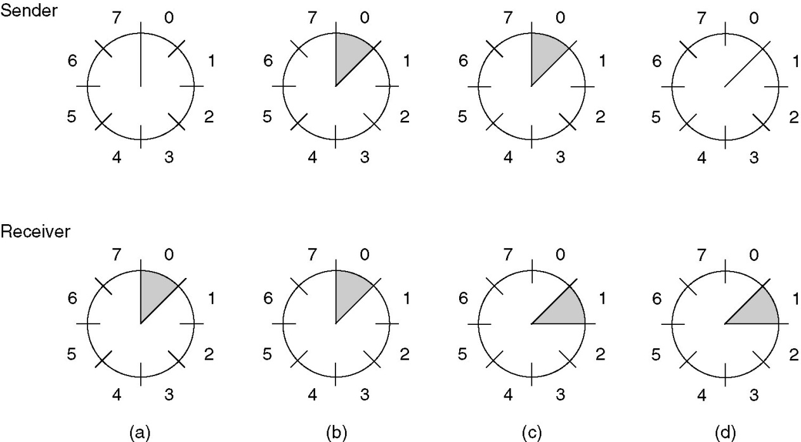
Sliding Window Protocols (2)
A sliding window of size 1, with a 3-bit sequence number.
(a) Initially.
(b) After the first frame has been sent.
(c) After the first frame has been received.
(d) After the first acknowledgement has been received.

Slide 48
A One-Bit Sliding Window Protocol
A sliding window protocol with a window size of 1.
Next frame to send tells which frame the sender is trying to send. Similarly, frame expected tells which frame the receiver is expecting. In both cases, 0 and 1 are the only possibilities.
The acknowledgement field contains the number of the last frame received without error.

Slide 49
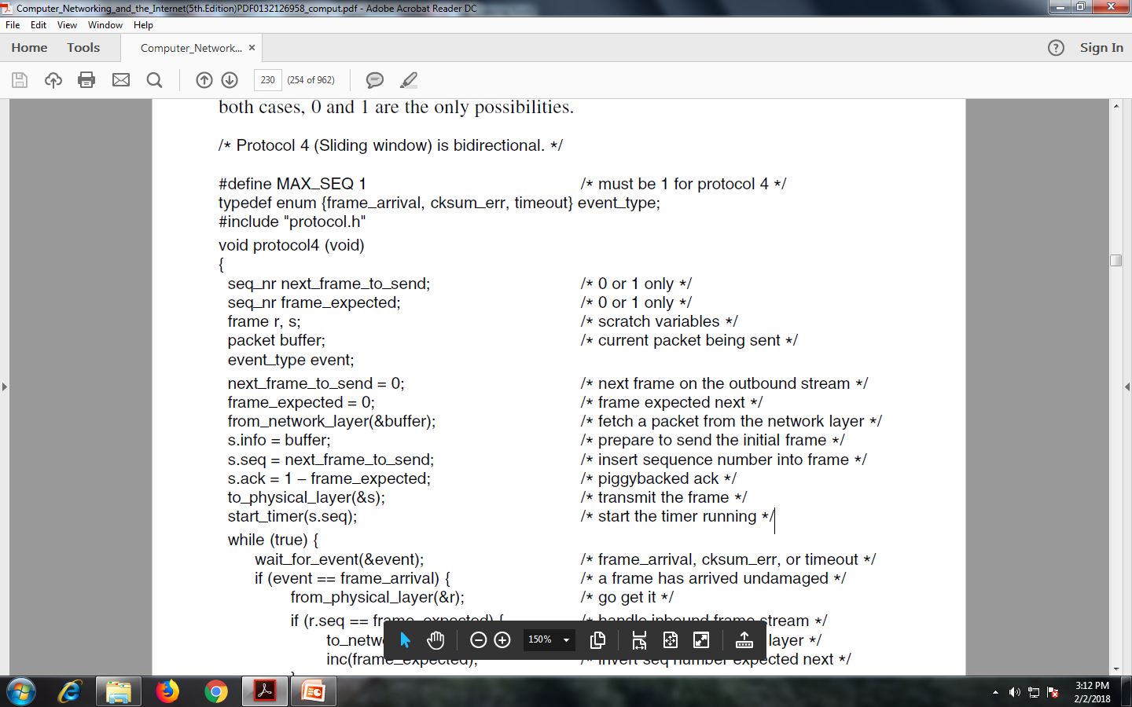
A One-Bit Sliding Window Protocol (ctd.)

Slide 50
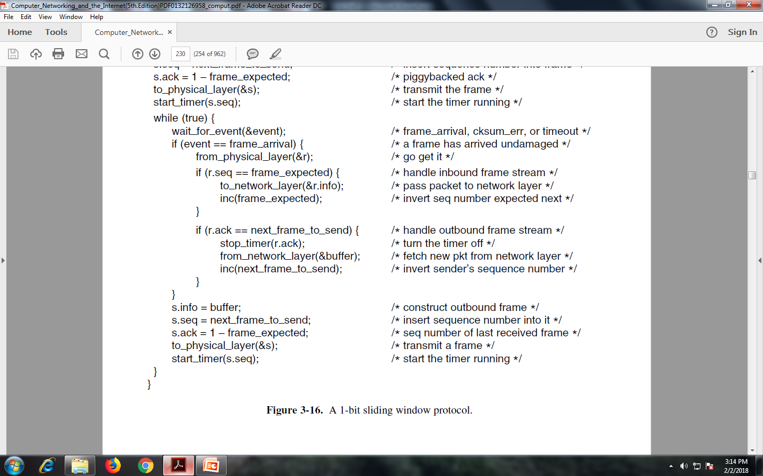
A One-Bit Sliding Window Protocol (ctd.)

Slide 51
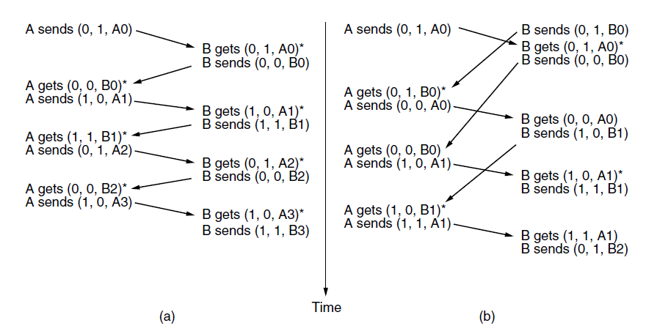
A One-Bit Sliding Window Protocol (2)
Two scenarios for Protocol 4 (Sliding window): is bidirectional
Normal case.
Abnormal case.
The notation is (seq, ack, packet number).
An asterisk(*) indicates where a network layer accepts a packet.

Slide 52
A Protocol Using Go-Back-N
Clearly, the combination of a long transit time, high bandwidth, and short frame length is disastrous in terms of efficiency.
Pipelining frames over an unreliable communication channel raises some serious issues.
First, what happens if a frame in the middle of a long stream is damaged or lost? Large numbers of succeeding frames will arrive at the receiver before the sender even finds out that anything is wrong.
When a damaged frame arrives at the receiver, it obviously should be discarded, but what should the receiver do with all the correct frames following it? Remember that the receiving data link layer is obligated to hand packets to the network layer in sequence.

Slide 53
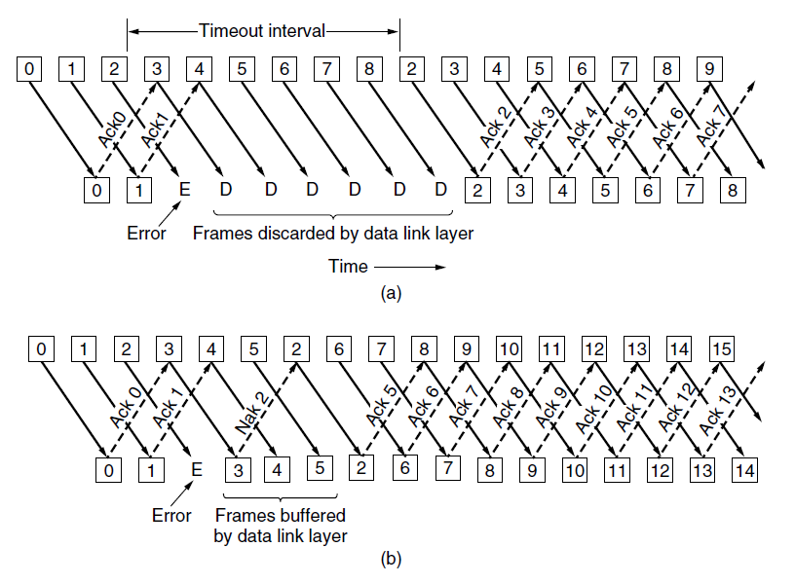
Two basic approaches are available for dealing with errors in the presence of pipelining.
Pipelining and error recovery. Effect of an error when
(a) receiver’s window size is 1 and (b) receiver’s window size is large.

Slide 54
One option, called go-back-n, is for the receiver simply to discard all subsequent frames, sending no acknowledgements for the discarded frames.
This strategy corresponds to a receive window of size 1. In other words, the data link layer refuses to accept any frame except the next one it must give to the network layer.
If the sender’s window fills up before the timer runs out, the pipeline will begin to empty.
Eventually, the sender will time out and retransmit all unacknowledged frames in order, starting with the damaged or lost one.
This approach can waste a lot of bandwidth if the error rate is high.
In Fig. (b) we see go-back-n for the case in which the receiver’s window is large. Frames 0 and 1 are correctly received and acknowledged. Frame 2, however, is damaged or lost.
The sender, unaware of this problem, continues to send frames until the timer for frame 2 expires.
Then it backs up to frame 2 and starts over with it, sending 2, 3, 4, etc. all over again.

Slide 55
The other general strategy for handling errors when frames are pipelined is called selective repeat.
When it is used, a bad frame that is received is discarded, but any good frames received after it are accepted and buffered.
When the sender times out, only the oldest unacknowledged frame is retransmitted.
If that frame arrives correctly, the receiver can deliver to the network layer, in sequence, all the frames it has buffered. Selective repeat corresponds to a receiver window larger than 1.
This approach can require large amounts of data link layer memory if the window is large.
Selective repeat is often combined with having the receiver send a negative acknowledgement (NAK) when it detects an error, for example, when it receives a checksum error or a frame out of sequence.
NAKs stimulate retransmission before the corresponding timer expires and thus improve performance.

Slide 56
consider the following scenario with MAX SEQ = 7:
1. The sender sends frames 0 through 7.
2. A piggybacked acknowledgement for 7 comes back to the sender.
3. The sender sends another eight frames, again with sequence numbers 0 through 7.
4. Now another piggybacked acknowledgement for frame 7 comes in.
/* Protocol 5 (Go-back-n) allows multiple outstanding frames. The sender may transmit up to MAX SEQ frames without waiting for an ack. In addition, unlike in the previous protocols, the network layer is not assumed to have a new packet all the time. Instead, the network layer causes a network layer ready event when there is a packet to send. */

Slide 57
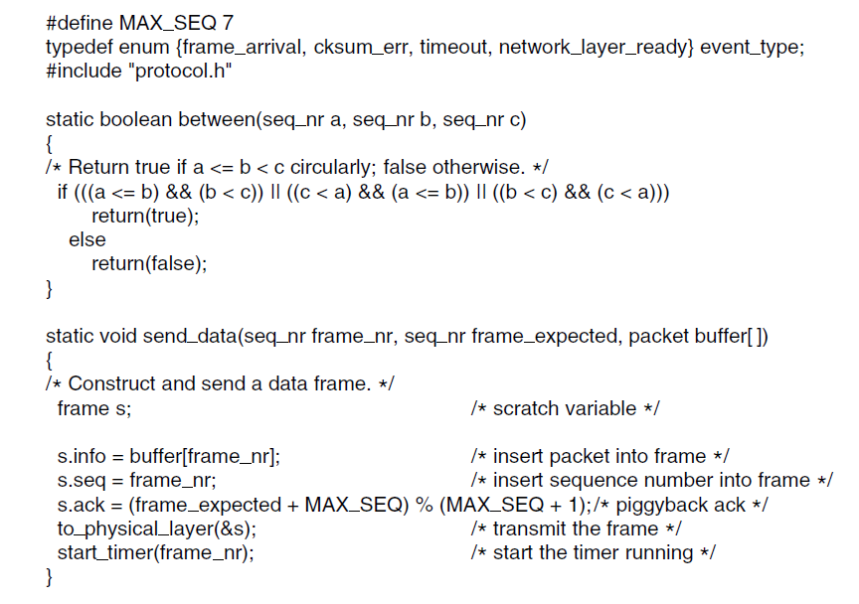
Sliding Window Protocol Using Go Back N
Continued →

Slide 58
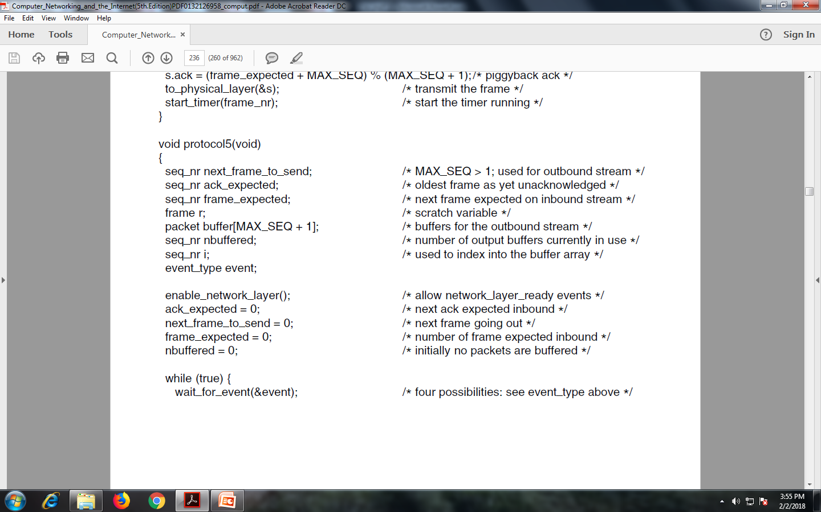

Slide 59
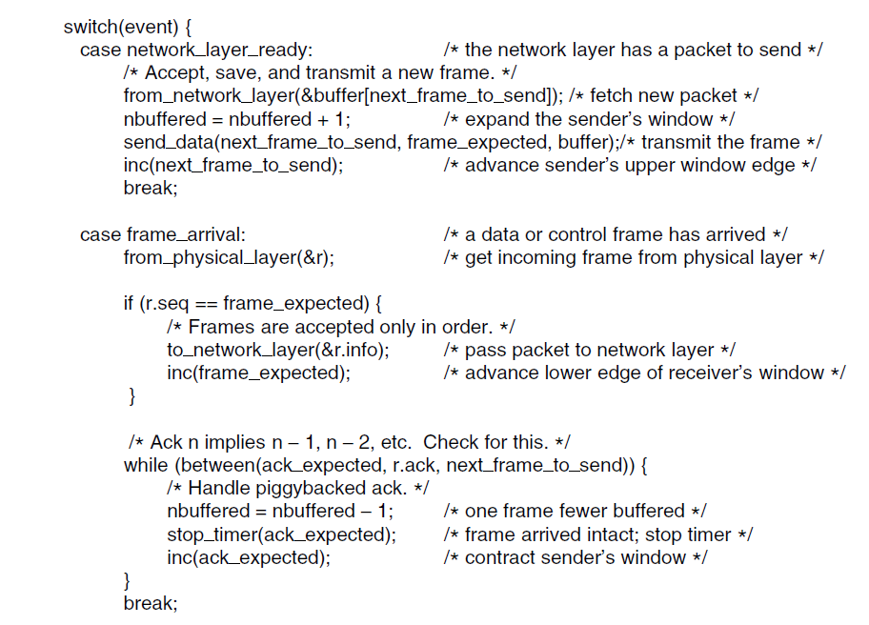

Slide 60
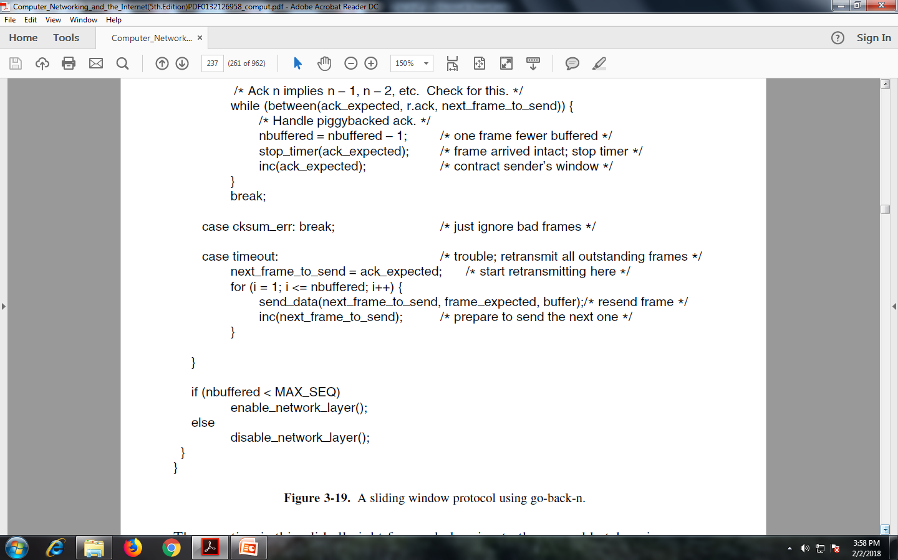

Slide 61
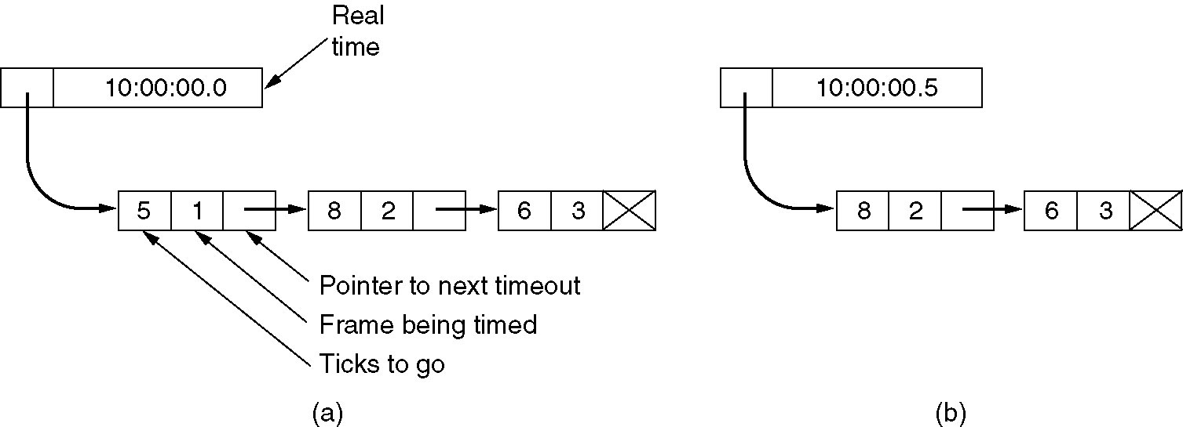
Sliding Window Protocol Using Go Back N (2)
Simulation of multiple timers in software.
Simulation of multiple timers in software.
(a) The queued timeouts.
(b) The situation after the first timeout has expired.
(a) Assume that the clock ticks once every 1 msec. Initially, the real time is 10:00:00.000; three timeouts are pending, at 10:00:00.005,
10:00:00.013, and 10:00:00.019. Every time the hardware clock ticks, the real time is updated and the tick counter at the head of the list is decremented. When the tick counter becomes zero, a timeout is caused and the node is removed from the list,

Slide 62
As shown in Fig. (b). Although this organization requires the list to be scanned when start timer or stop timer is called, it does not require much work per tick. In protocol 5, both of these routines have been given a parameter indicating which frame is to be timed.
A Protocol Using Selective Repeat
The go-back-n protocol works well if errors are rare, but if the line is poor it wastes a lot of bandwidth on retransmitted frames.
An alternative strategy, the selective repeat protocol, is to allow the receiver to accept and buffer the frames following a damaged or lost one.
Both sender and receiver maintain a window of outstanding and acceptable sequence numbers, respectively.
The sender’s window size starts out at 0 and grows to some predefined maximum. The receiver’s window, in contrast, is always fixed in size and equal to the predetermined maximum.
The receiver has a buffer reserved for each sequence number within its fixed window.

Slide 63
/* Protocol 6 (Selective repeat) accepts frames out of order but passes packets to the network layer in order. Associated with each outstanding frame is a timer. When the timer expires, only that frame is retransmitted, not all the outstanding frames, as in protocol 5. */

Slide 64
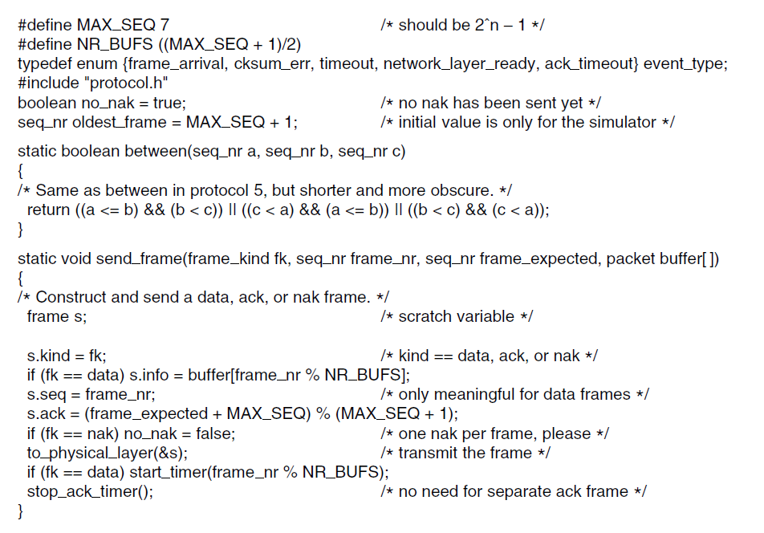

Slide 65
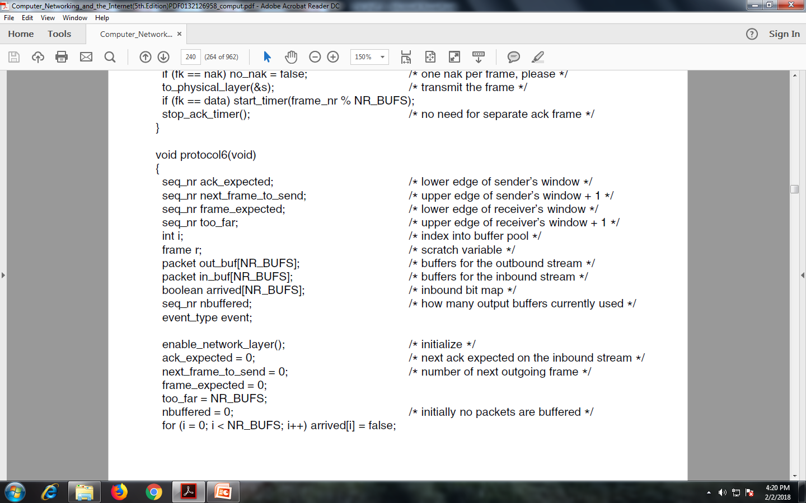

Slide 66
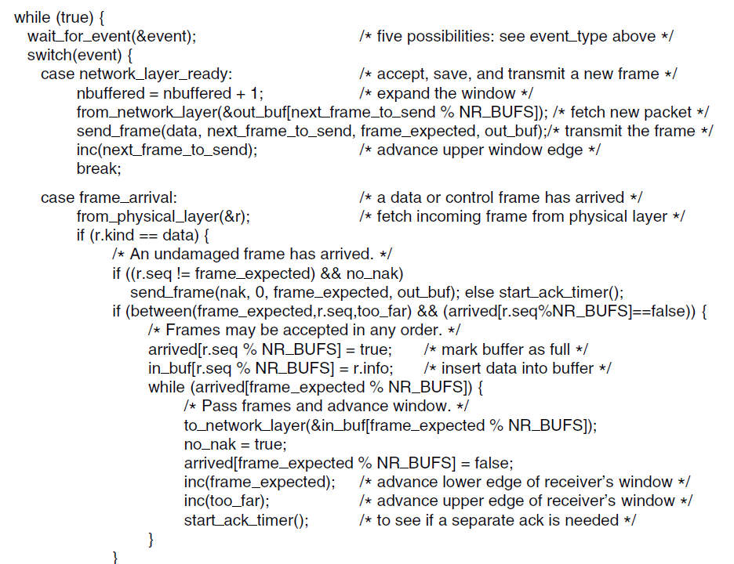

Slide 67
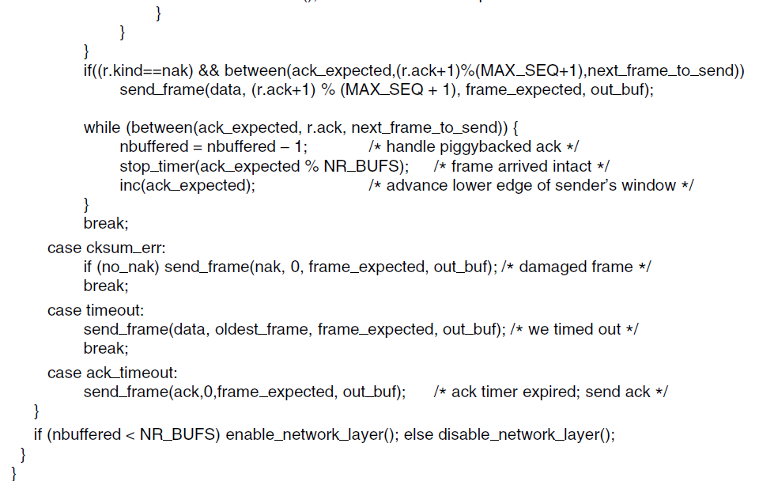

Slide 68
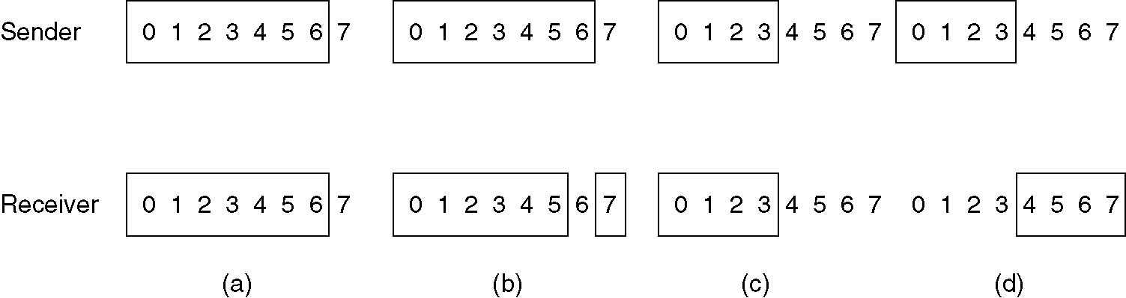
A Sliding Window Protocol Using Selective Repeat (5)
(a) Initial situation with a window size 7.
(b) After 7 frames sent and received, but not acknowledged.
(c) Initial situation with a window size of 4.
(d) After 4 frames sent and received, but not acknowledged.

Slide 69
EXAMPLE DATA LINK PROTOCOLS
The data link protocols found on point-to-point lines in the Internet in two common situations.
The first situation is when packets are sent over SONET optical fiber links in wide-area networks. These links are widely used, for example, to connect routers in the different locations of an ISP’s network.
The second situation is for ADSL links running on the local loop of the telephone network at the edge of the Internet. These links connect millions of individuals and businesses to the Internet.
The Internet needs point-to-point links for these uses, as well as dial-up modems, leased lines, and cable modems, and so on.
A standard protocol called PPP (Point-to-Point Protocol) is used to send packets over these links.
PPP is defined in RFC 1661 and further elaborated in RFC 1662 and other RFCs (Simpson, 1994a, 1994b).
SONET and ADSL links both apply PPP, but in different ways.

Slide 70
THE MEDIUM ACCESS CONTROL SUBLAYER
In the literature, broadcast channels are sometimes referred to as multiaccess channels or random access channels.
The protocols used to determine who goes next on a multiaccess channel belong to a sublayer of the data link layer called the MAC (Medium Access Control) sublayer.

Slide 71
THE CHANNEL ALLOCATION PROBLEM
How to allocate a single broadcast channel among competing users.
Static Channel Allocation
Assumptions for Dynamic Channel Allocation
Static Channel Allocation
The traditional way of allocating a single channel, such as a telephone trunk, among multiple competing users is to chop up its capacity by using one of the multiplexing schemes- FDM (Frequency Division Multiplexing).
If there are N users, the bandwidth is divided into N equal-sized portions, with each user being assigned one portion.
Since each user has a private frequency band, there is now no interference among users.
if more than N users want to communicate, some of them will be denied permission for lack of bandwidth,

Slide 72
Static Allocation is a poor fit to most computer systems, in which data traffic is extremely bursty. Consequently, most of the channels will be idle most of the time.
The poor performance of static FDM.
2. Assumptions for Dynamic Channel Allocation
five key assumptions:
Independent Traffic.
The model consists of N independent stations
(e.g., computers, telephones), each with a program or user that generates frames for transmission. The expected number of frames generated in an interval of length Δt is λΔt, where λ is a constant (the arrival rate of new frames). Once a frame has been generated, the station is blocked and does nothing until the frame has been successfully transmitted.
2. Single Channel. A single channel is available for all communication. All stations can transmit on it and all can receive from it. The stations are assumed to be equally capable, though protocols may assign them different roles (e.g., priorities).

Slide 73
3. Observable Collisions. If two frames are transmitted simultaneously, they overlap in time and the resulting signal is garbled. This event is called a collision. All stations can detect that a collision has occurred. A collided frame must be transmitted again later. No errors other than those generated by collisions occur.
4. Continuous or Slotted Time. Time may be assumed continuous, in which case frame transmission can begin at any instant. Alternatively, time may be slotted or divided into discrete intervals (called slots). Frame transmissions must then begin at the start of a slot. A slot may contain 0, 1, or more frames, corresponding to an idle slot, a successful transmission, or a collision, respectively.
5. Carrier Sense or No Carrier Sense. With the carrier sense assumption, stations can tell if the channel is in use before trying to use it. No station will attempt to use the channel while it is sensed as busy. If there is no carrier sense, stations cannot sense the channel before trying to use it. They just go ahead and transmit. Only later can they determine whether the transmission was successful.

Slide 74
Channel Allocation Problem
For fixed channel and traffic from N users
Divide up bandwidth using FTM, TDM, CDMA, etc.
This is a static allocation, e.g., FM radio
This static allocation performs poorly for bursty traffic
Allocation to a user will sometimes go unused.
Dynamic allocation Assumptions gives the channel to a user when they need it. Potentially N times as efficient for N users.
Assumption | Implication
Independent traffic | Often not a good model, but permits analysis
Single channel | No external way to coordinate senders
Observable collisions | Needed for reliability; mechanisms vary
Continuous or slotted time | Slotting may improve performance
Carrier sense | Can improve performance if available

Slide 75
Multiple Access Protocols
ALOHA
CSMA (Carrier Sense Multiple Access)
Collision-free protocols
Limited-contention protocols

Slide 76
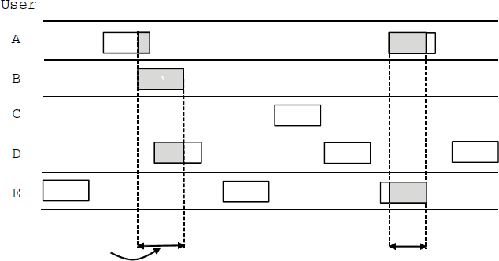
ALOHA
In pure ALOHA, users transmit frames whenever they have data; users retry after a random time for collisions
Efficient and low-delay under low load
`
User
A B C D E
Collision
Collision
Time

Slide 77
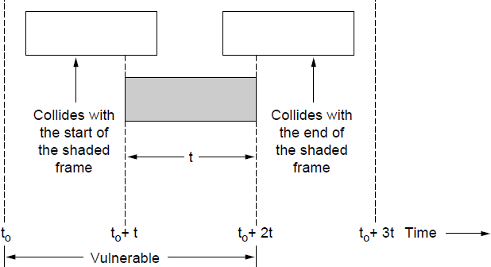
ALOHA
Collisions happen when other users transmit during a vulnerable period that is twice the frame time
Synchronizing senders to slots can reduce collisions

Slide 78
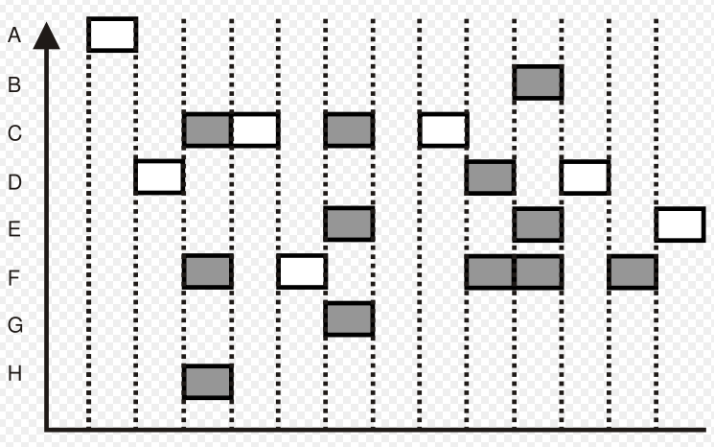
Slotted ALOHA
Divide time into discrete intervals Each interval corresponds to 1 frame

Slide 79
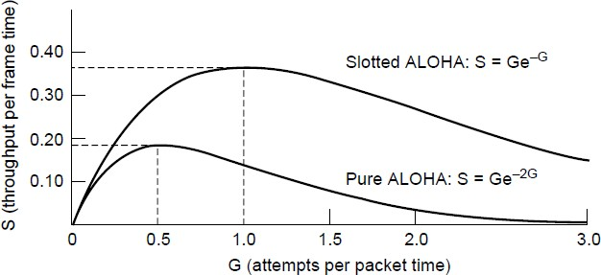
ALOHA
Slotted ALOHA is twice as efficient as pure ALOHA
Low load wastes slots, high loads causes collisions
Efficiency up to 1/e (37%) for random traffic models

Slide 80
CSMA
CSMA improves on ALOHA by sensing the channel!
User doesn’t send if it senses someone else.
Variations on what to do if the channel is busy:
1-persistent (greedy) sends as soon as idle
Nonpersistent waits a random time then tries again
p-persistent sends with probability p when idle
Stations soon know transmission has started so first listen for
clear medium (carrier sense) if medium idle, transmit.
if two stations start at the same instant, collision
wait reasonable time
if no ACK then retransmit
collisions occur at leading edge of frame
Max utilization depends on propagation time (medium length)
and frame length

Slide 81
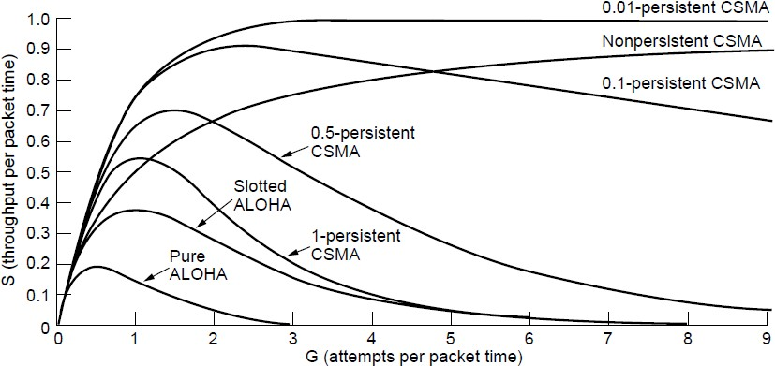
CSMA (2) – Persistence
CSMA outperforms ALOHA, and being less persistent is better under high load
Comparison of the channel utilization versus load for various random access protocols.

Slide 82
Nonpersistent CSMA
Nonpersistent CSMA rules:
if medium idle, transmit
if medium busy, wait amount of time drawn from
probability distribution (retransmission delay) & retry random delays reduces probability of collisions capacity is wasted because medium will remain idle following end of transmission.
nonpersistent stations are deferential

Slide 83
1-persistent CSMA
1-persistent CSMA avoids idle channel time
persistent CSMA rules:
if medium idle, transmit;
if medium busy, listen until idle; then transmit
immediately
1-persistent stations are selfish
if two or more stations waiting, a collision is guaranteed

Slide 84
P-persistent CSMA
a compromise to try and reduce collisions and idle time
P-persistent CSMA rules:
if medium idle, transmit with probability p, and delay one time unit with probability (1–p)
if medium busy, listen until idle and repeat step 1
if transmission is delayed one time unit, repeat step 1
issue of choosing effective value of p to avoid instability under heavy load

Slide 85
CSMA with Collision Detection
Persistent and nonpersistent CSMA protocols are definitely an improvement over ALOHA because they ensure that no station begins to transmit while the channel is busy.
However, if two stations sense the channel to be idle and begin transmitting simultaneously, their signals will still collide.
Another improvement is for the stations to quickly detect the collision and abruptly(suddenly) stop transmitting, (rather than finishing them) since they are irretrievably garbled anyway. This strategy saves time and bandwidth.
CSMA/CD improvement is to detect/abort collisions.
Reduced contention times improve performance

Slide 86
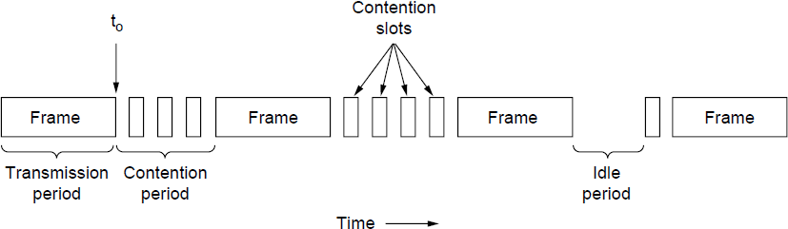
CSMA (3) –CSMA with Collision Detection
If two or more stations decide to transmit simultaneously, there will
be a collision.
If a station detects a collision, it aborts its transmission, waits a
random period of time, and then tries again (assuming that no other
station has started transmitting in the meantime).
Therefore, our model for CSMA/CD will consist of alternating
contention and transmission periods, with idle periods occurring
when all stations are quiet (e.g., for lack of work).
CSMA/CD can be in contention, transmission, or idle state.

Slide 87
The minimum time to detect the collision is just the time it takes the signal to propagate from one station to the other.
improve performance if the frame time is much longer than the propagation time.(Collision time is much shorter than frame time).
Although collisions do not occur with CSMA/CD once a station has unambiguously captured the channel, they can still occur during the contention(conflict) period.
These collisions adversely affect the system performance, especially when the bandwidth-delay product is large, such as when the cable is long and the frames are short. Not only do collisions reduce bandwidth, but they make the time to send a frame variable, which is not a good fit for real-time traffic such as voice over IP.
CSMA/CD is also not universally applicable.

Slide 88
CSMA/CD
with CSMA, collision occupies medium for duration of transmission.
better if stations listen whilst transmitting
CSMA/CD rules:
if medium idle, transmit
if busy, listen for idle, then transmit
if collision detected, jam and then cease
transmission
after jam, wait random time then retry

Slide 89
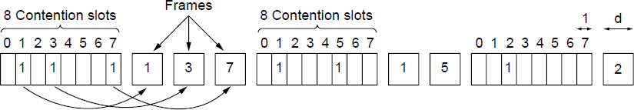
Collision-Free Protocol (1)
Bit-Map Protocol
each contention period consists of exactly N slots. If station 0 has a frame to send, it transmits a 1 bit during the slot 0. No other station is allowed to transmit during this slot. Regardless of what station 0 does, station 1 gets the opportunity to transmit a 1 bit during slot 1, but only if it has a frame queued.
each station has complete knowledge of which stations wish to transmit.
Collision-free protocols avoid collisions entirely
Senders must know when it is their turn to send
The basic bit-map protocol:
Sender set a bit in contention slot if they have data
Senders send in turn; everyone knows who has data

Slide 90
Reservation protocols because they reserve channel ownership in advance and prevent collisions.
Under conditions of low load, the bit map will simply be repeated over and over, for lack of data frames.
On average, the station will have to wait N /2 slots for the current scan to finish and another full N slots for the following scan to run to completion before it may begin transmitting.
High numbered stations rarely have to wait for the next scan.
Since low-numbered stations must wait on average 1.5N slots and high-numbered stations must wait on average 0.5N slots, the mean for all stations is N slots.
The channel efficiency at low load is easy to compute. The overhead per frame is N bits and the amount of data is d bits, for an efficiency of d /(d + N).
At high load, when all the stations have something to send all the time, the Nbit contention period is prorated over N frames, yielding an overhead of only 1 bit per frame, or an efficiency of d /(d + 1).
The mean delay for a frame is equal to the sum of the time it queues inside its station, plus an additional (N − 1)d + N once it gets to the head of its internal queue. This interval is how long it takes to wait for all other stations to have their turn sending a frame and another bitmap.

Slide 91
Collision-Free (2) – Token Ring
The essence of the bit-map protocol is that it lets every station transmit a frame in turn in a predefined order.
Another way to accomplish the same thing is to pass a small message called a token from one station to the next in the same predefined order.
The token represents permission to send.
If a station has a frame queued for transmission when it receives the token, it can send that frame before it passes the token to the next station. If it has no queued frame, it simply passes the token.
In a token ring protocol, the topology of the network is used to define the order in which stations send.
The stations are connected one to the next in a single ring. Passing the token to the next station then simply consists of receiving the token in from one direction and transmitting it out in the other direction.
Frames are also transmitted in the direction of the token.

Slide 92
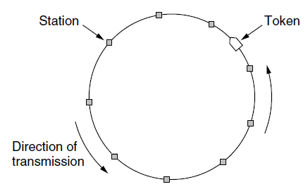
Collision-Free (2) – Token Ring (Cont..)
Token sent round ring defines the sending order
Station with token may send a frame before passing
Idea can be used without ring too, e.g., token bus
Note that we do not need a physical ring to implement token passing.
Each station then uses the bus to send the token to the next station in
the predefined sequence.
Possession of the token allows a station to use the bus to send one
frame, as before. This protocol is called token bus.

Slide 93
The performance of token passing is similar to that of the bit-map protocol, though the contention slots and frames of one cycle are now intermingled.
After sending a frame, each station must wait for all N stations (including itself) to send the token to their neighbors and the other N − 1 stations to send a frame, if they have one.
For token ring, each station is also sending the token only as far as its neighboring station before the protocol takes the next step. Each token does not need to propagate to all stations before the protocol advances to the next step.
An early token ring protocol (called ‘‘Token Ring’’ and standardized as IEEE 802.5) was popular in the 1980s as an alternative to classic Ethernet.
In the 1990s, a much faster token ring called FDDI (Fiber Distributed Data Interface) was beaten out by switched Ethernet.
In the 2000s, a token ring called RPR (Resilient Packet Ring) was defined as IEEE 802.17 to standardize the mix of metropolitan area rings in use by ISPs.

Slide 94
A problem with the basic bit-map protocol, and by extension token passing, is that the overhead is 1 bit per station, so it does not scale well to networks with thousands of stations.
We can do better than that by using binary station addresses with a channel that combines transmissions.
A station wanting to use the channel now broadcasts its address as a binary bit string, starting with the high order bit.
All addresses are assumed to be the same length.
The bits in each address position from different stations are BOOLEAN ORed together by the channel when they are sent at the same time. We will call this protocol binary countdown.
It was used in Datakit (Fraser, 1987). It implicitly assumes that the transmission delays are negligible so that all stations see asserted bits essentially instantaneously.
To avoid conflicts, an arbitration rule must be applied: as soon as a station sees that a high-order bit position that is 0 in its address has been overwritten with a 1, it gives up.

Slide 95
For example, if stations 0010, 0100, 1001, and 1010 are all trying to get the channel, in the first bit time the stations transmit 0, 0, 1, & 1, (0010, 0100, 1001, and 1010 ) respectively.
These are ORed together to form a 1.
Stations 0010 and 0100 see the 1 and know that a higher-numbered station is competing for the channel, so they give up for the current round. Stations 1001 and 1010 continue.
The next bit is 0, and both stations continue. The next bit is 1, so station 1001 gives up.
The winner is station 1010 because it has the highest address.
After winning the bidding, it may now transmit a frame, after which another bidding cycle starts.
The property that higher-numbered stations have a higher priority than lower-numbered stations, which may be either good or bad, depending on the context.

Slide 96
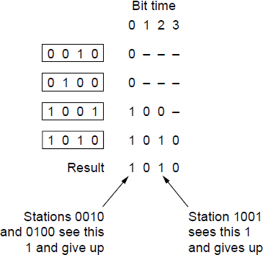
Collision-Free (3) – Binary Countdown
Binary countdown improves on the bitmap protocol
Stations send their address in contention slot (log N bits instead of N bits)
Medium ORs bits; stations give up when they send a “0” but see a “1”
Station that sees its full address is next to send
The channel efficiency of Binary Countdown is
d /(d + log2 N).
The binary countdown protocol.
A dash indicates silence

Slide 97
The two important performance measures:
Delay at low load and Channel Efficiency At High Load.
Under conditions of light load, contention (i.e., pure or slotted ALOHA) is preferable due to its low delay (since collisions are rare).
As the load increases, contention becomes increasingly less attractive because the overhead associated with channel arbitration becomes greater.
Just the reverse is true for the collision-free protocols. At low load, they have relatively high delay but as the load increases, the channel efficiency improves (since the overheads are fixed).
The combination of the best properties of the contention and collision-free protocols, arriving at a new protocol that used contention at low load to provide low delay, but used a collision-free technique at high load to provide good channel efficiency - limited-contention protocols.

Slide 98
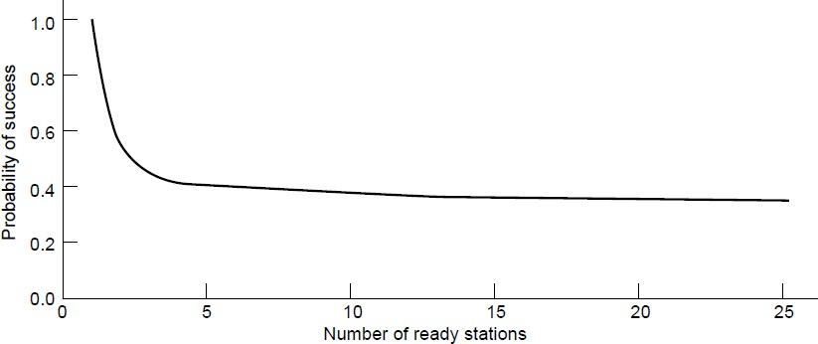
Limited-Contention Protocols (1)
First divide the stations into (not necessarily disjoint) groups. Only the members of group 0 are permitted to compete for slot 0.
If one of them succeeds, it acquires the channel and transmits its frame.
If the slot lies fallow or if there is a collision, the members of group 1 contend for slot 1, etc.
For small numbers of stations, the chances of success are good, but as soon as the number of stations reaches even five, the probability has dropped close to its asymptotic value of 1/e.
Avoids wastage due to idle periods and collisions.
Already too many contenders for a good chance of one winner

Slide 99
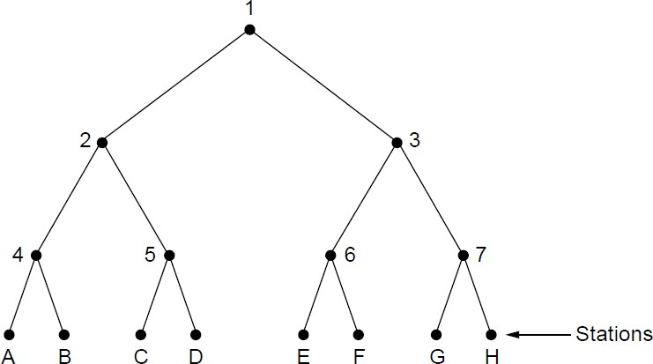
Limited Contention (2) –Adaptive Tree Walk 275
Tree divides stations into groups (nodes) to poll
Depth first search under nodes with poll collisions
Start search at lower levels if >1 station expected
Level 0
Level 1
Level 2

Slide 100
Ethernet
Classic Ethernet »
Switched/Fast Ethernet »
Gigabit/10 Gigabit Ethernet »

Slide 101
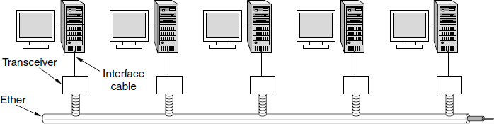
Classic Ethernet (1) – Physical Layer
One shared coaxial cable to which all hosts attached
Up to 10 Mbps, with Manchester encoding
Hosts ran the classic Ethernet protocol for access

Slide 102
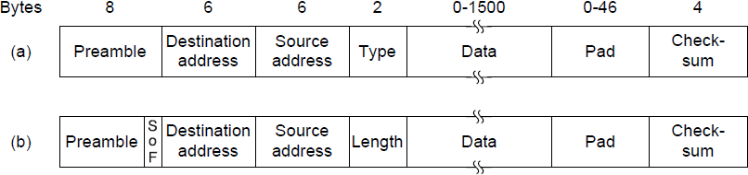
Classic Ethernet (2) – MAC
MAC protocol is 1-persistent CSMA/CD (earlier)
Random delay (backoff) after collision is computed
with BEB (Binary Exponential Backoff)
Frame format is still used with modern Ethernet.
Ethernet
(DIX)
IEEE
802.3

Slide 103
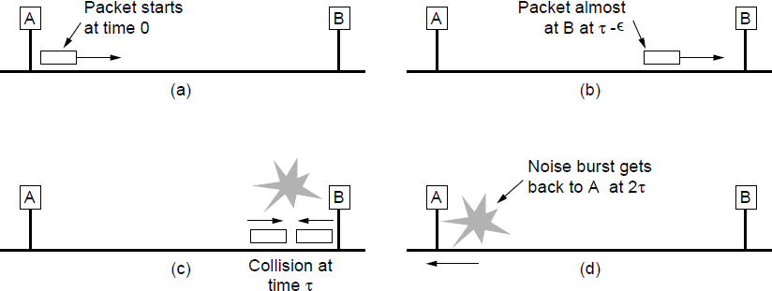
Classic Ethernet (3) – MAC
Collisions can occur and take as long as 2τ to detect
τ is the time it takes to propagate over the Ethernet
Leads to minimum packet size for reliable detection

Slide 104
Binary Exponential Backoff
for backoff stability, IEEE 802.3 and Ethernet both use binary exponential backoff
stations repeatedly resend when collide
on first 10 attempts, mean random delay doubled
value then remains same for 6 further attempts
after 16 unsuccessful attempts, station gives up and reports error
1-persistent algorithm with binary exponential backoff efficient over wide range of loads
but backoff algorithm has last-in, first-out effect

Slide 105
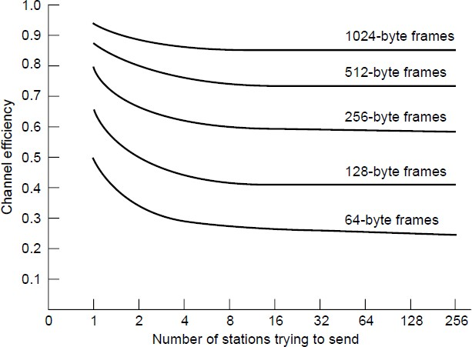
Classic Ethernet (4) – Performance
Efficient for large frames, even with many senders
Degrades for small frames (and long LANs)
10 Mbps Ethernet,
64 byte min. frame

Slide 106
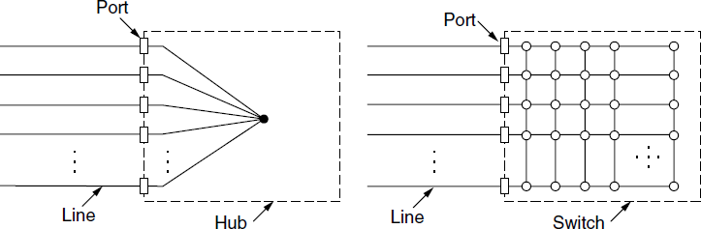
Switched/Fast Ethernet (1)
Hubs wire all lines into a single CSMA/CD domain
Switches isolate each port to a separate domain
Much greater throughput for multiple ports
No need for CSMA/CD with full-duplex lines

Slide 107
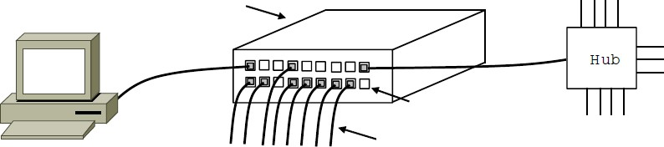
Switched/Fast Ethernet (2)
Switches can be wired to computers, hubs and switches
Hubs concentrate traffic from computers
More on how to switch frames the in 4.8
Switch
Hub
Switch ports
Twisted pair

Slide 108
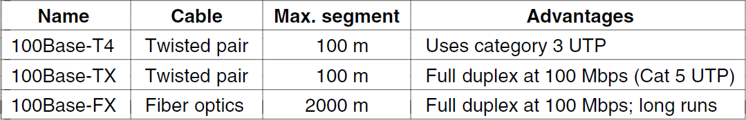
Switched/Fast Ethernet (3)
Fast Ethernet extended Ethernet from 10 to 100 Mbps
Twisted pair (with Cat 5) dominated the market

Slide 109

Gigabit / 10 Gigabit Ethernet (1)
Switched Gigabit Ethernet is now the garden variety
With full-duplex lines between computers/switches

Slide 110


Gigabit / 10 Gigabit Ethernet (1)
Gigabit Ethernet is commonly run over twisted pair
10 Gigabit Ethernet is being deployed where needed
40/100 Gigabit Ethernet is under development

Slide 111
Data Link Layer- Switching
Uses of Bridges »
Learning Bridges »
Spanning Tree »
Repeaters, hubs, bridges, .., routers, gateways »

Slide 112

Uses of Bridges
Common setup is a building with centralized wiring
Bridges (switches) are placed in or near wiring closets
Bridges operate in the data link layer

Slide 113

Learning Bridges (1)
A bridge operates as a switched LAN (not a hub)
Computers, bridges, and hubs connect to its ports
The algorithm used by the bridges is backward learning.
Backward learning algorithm picks the output port:
Associates source address on frame with input port
Frame with destination address sent to learned port
Unlearned destinations are sent to all other ports
Needs no configuration
Forget unused addresses to allow changes
Bandwidth efficient for two-way traffic

Slide 114
The routing procedure for an incoming frame depends on the port it arrives on (the source port) and the address to which it is destined (the destination address).
The procedure is as follows.
If the port for the destination address is the same as the source port, discard the frame.
If the port for the destination address and the source port are different, forward the frame on to the destination port.
If the destination port is unknown, use flooding and send the frame on all ports except the source port.
special-purpose VLSI chips- reduces the latency of passing through the bridge, as well as the number of frames that the bridge must be able to buffer. It is referred to as cut-through switching or wormhole routing and is usually handled in hardware.

Slide 115

Learning Bridges (3)
Bridges extend the Link layer:
Use but don’t remove Ethernet header/addresses
Do not inspect Network header

Slide 116

Spanning Tree (1) – Problem
To increase reliability, redundant links can be used between bridges. Redundancy introduces some problems because it
creates loops in the topology.
Bridge topologies with loops and only backward learning will cause frames to circulate for ever.
Need spanning tree support to solve problem
Bridges with two parallel links

Slide 117

A spanning tree connecting five bridges.
The dashed lines are links that are not part of the spanning tree.
To build the spanning tree, the bridges run a distributed algorithm. Each bridge periodically broadcasts a configuration message out all of its ports to its neighbors and processes the messages it receives from other bridges, as described next.
These messages are not forwarded, since their purpose is to build the tree, which can then be used for forwarding.

Slide 118
Spanning Tree (2) – Algorithm
The algorithm for constructing the spanning tree was invented by Radia Perlman. Her job was to solve the problem of joining LANs without loops.
Subset of forwarding ports for data is use to avoid loops
Spanning tree algorithm- poem (Perlman, 1985):
I think that I shall never see
A graph more lovely than a tree.
A tree whose crucial property
Is loop-free connectivity.
A tree which must be sure to span.
So packets can reach every LAN.
First the Root must be selected
By ID it is elected.
Least cost paths from Root are traced
In the tree these paths are placed.
A mesh is made by folks like me
Then bridges find a spanning tree.
The spanning tree algorithm was then standardized as IEEE 802.1D and used for
many years.

Slide 119

Spanning Tree (3) – Example
After the algorithm runs:
B1 is the root, two dashed links are turned off
B4 uses link to B2 (lower than B3 also at distance 1)
B5 uses B3 (distance 1 versus B4 at distance 2)

Slide 120


Repeaters, Hubs, Bridges, Switches, Routers, & Gateways
Devices are named according to the layer they process
A bridge or LAN switch operates in the Link layer
(a) Which device is in which layer. (b) Frames, packets, and headers.
Bridges offer much better performance than hubs.
Switches are modern bridges by another name.

Slide 121
Comparison Chart
BASIS FOR COMPARISON | BRIDGE | GATEWAY
Basic | Bridge transmits the frames between two separated segments of LAN. | Gateway is a protocol converter.
Layer of Operation | Operates on two layers, physical and data link layer. | Operates on all the seven layer of OSI model.
Work | Checks the destination address on received frame and forward the frame to the address it belongs. | It allows two different network using different protocols to communicate with each other.

